Slide 1

Insights
Briefing on trends, drivers and growth recommendations
By Lungile Chirwa

Slide 2
Introduction
The goal for this year is clear: grow Bright TV's subscriber base.
Using our user and viewing data, I've analyzed who watches, when they watch, and what they watch. Today, I'll share the key insights on our peak and low consumption patterns, the content that drives engagement, and a set of targeted initiatives the CVM team can implement immediately to boost viewership and acquire new users.

Slide 3
Presentation overview
Objective: Grow subscription base through actionable, data-driven insights Data: • User Profiles (demographics) • Viewership Transactions (SA time) Agenda: User & usage trends Consumption drivers Recommendations: content strategy + growth initiatives Key Message: Strong core audience — clear opportunities to increase consumption and acquisition this quarter

Slide 4

01
Understanding our User Base

Slide 5
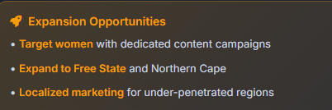
User demographics & segments
Our core audience is predominantly male and lives in Gauteng. This presents a significant opportunity to expand our user base by creating targeted acquisition campaigns for women and for subscribers in under-penetrated provinces like the Free State and Northern Cape

Slide 6
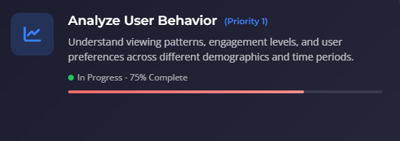
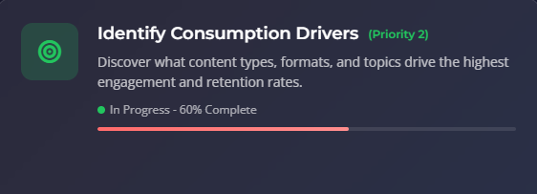
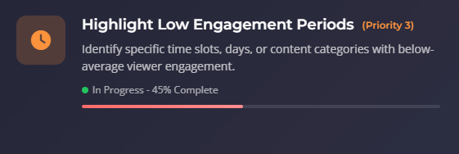
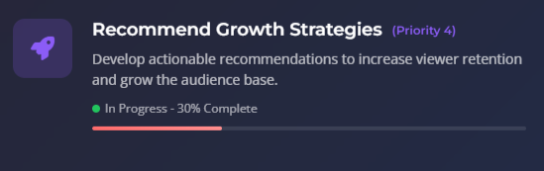
Viewership Analytics

Slide 7
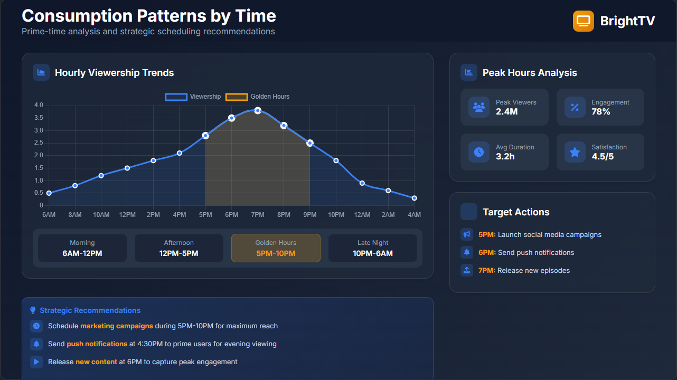

Slide 8
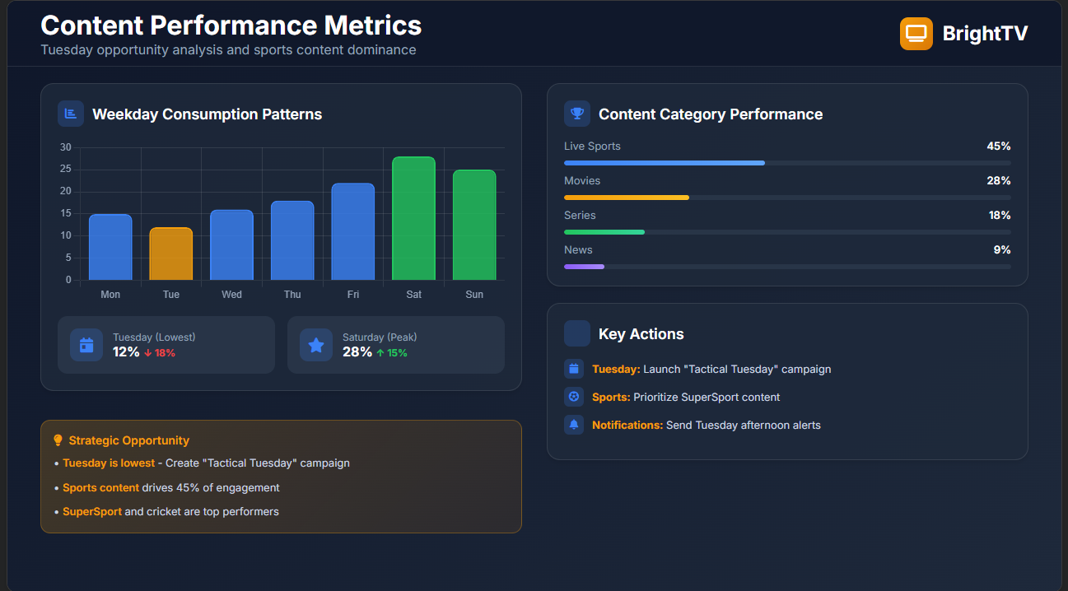

Slide 9

02
Growth Initiatives

Slide 10
The "Tactical Tuesday" Campaign
Create
Create a weekly themed campaign specifically for Tuesdays to drive viewership
Content
Exclusive Content: Schedule a popular weekly show, a "mid-week match" replay, or exclusive behind-the-scenes sports content for Tuesday nights.
Send
Targeted Push Notifications: Send a "Don't miss out on Tactical Tuesday!" notification to all users on Tuesday afternoon (e.g., 16:00).
Offer
Incentives: Offer a small data prize or a "double loyalty points" for subscribers who watch for more than 60 minutes on Tuesday evening.

Slide 11
Targeted Acquisition & Content for Female Subscribers
Marketing: Run targeted social media campaigns on platforms like Instagram and Facebook with creative featuring female-friendly content (e.g., reality TV, lifestyle shows, drama series).
Content Curation: Create a dedicated "Women of Bright TV" content rail on the homepage, highlighting popular shows among existing female users (e.g., Africa Magic, Trace TV).
Partnerships: Partner with female-focused brands for co-marketing and exclusive subscriber offers.

Slide 12
Use Top Content to Lift Off-Peak Hours
Leverage our most popular sports content to drive consumption during the late morning and early afternoon lulls (10:00 - 15:00).
Replays & Highlights: Schedule major match replays and highlight shows during the 10:00-15:00 time slot on weekdays.
"Lunchtime Legends" Series: Create a daily, 30-minute talk show hosted by a sports personality, airing at 13:00.
On-Demand Library: Promote the depth of the on-demand sports archive (e.g., "Watch the full Cricket World Cup final now!") in off-peak push notifications.

Slide 13

Acquisition & partnership strategies
Pursue co-productions, distribution partnerships, and bundled offers with telcos and platforms to expand reach.
Leverage targeted paid/social campaigns and referral incentives focused on high-LTV segments to scale efficiently.

Slide 14
Conclusions
Prioritize data-driven scheduling, short-form content on low days, and personalization to raise engagement.
Focus on Tuesday with a dedicated "Tactical Tuesday" campaign.
Prioritize Sports content (SuperSport, Cricket) in all marketing.
Launch targeted initiatives to grow the female subscriber base.

Slide 15
Thanks!

